Slide 1

MINI PROJECT
Object Oriented Programming Laboratory

Slide 2
WONDER WOMEN'S
PRESENTED BY
GAYATHRI G - 21IT11
LAVANYA R - 21IT26
KRUTHIKA S - 21IT24

Slide 3
Body Mass Index calculator
BMI is a body mass index calculator used to measure the person's leanness or corpulence based on their height and weight and is intended to quantify tissue mass. It is widely used as a general indicator of whether a person has a healthy body weight for their height. Specifically, the value obtained from the calculation of BMI is used to categorize whether a person is underweight, normal weight, overweight, or obese depending on what range the value falls between.

Slide 4
program
import java.awt.event.ActionEvent;
import java.awt.event.ActionListener;
import javax.swing.JButton;
import javax.swing.JFrame;
import javax.swing.JLabel;
import javax.swing.JTextField;
/**
*
* @author H2O
*/
public class JavaExamples extends javax.swing.JFrame {
JavaExamples() {
JFrame f = new JFrame();//creating instance of JFrame
JLabel lb1 = new JLabel("Height(Inches):");
lb1.setBounds(20, 20, 100, 40);//x axis, y axis, width, height
f.add(lb1); //adding component in JFrame

Slide 5
JLabel lb2 = new JLabel("Weight(Pounds):");
lb2.setBounds(20, 60, 100, 40);//x axis, y axis, width, height
f.add(lb2); //adding component in JFrame
JLabel lbResult = new JLabel("BMI Calculator in JAVA GUI");
lbResult.setBounds(20, 90, 300, 40);//x axis, y axis, width, height
f.add(lbResult); //adding component in JFrame
JTextField txtHeight = new JTextField("");
txtHeight.setBounds(120, 20, 200, 40);//x axis, y axis, width, height
f.add(txtHeight); //adding component in JFrame
JTextField txtWeight = new JTextField("");
txtWeight.setBounds(120, 60, 200, 40);//x axis, y axis, width, height
f.add(txtWeight); //adding component in JFrame
JButton btn = new JButton("BMI Calculator in JAVA GUI(CALCULATE)");//creating instance of JButton
btn.setBounds(20, 130, 300, 40);//x axis, y axis, width, height

Slide 6
//Event
btn.addActionListener(new ActionListener(){
@Override
public void actionPerformed(ActionEvent e) {
double weight=Double.parseDouble(txtWeight.getText());
double height=Double.parseDouble(txtHeight.getText());
double bmi = weight / Math.pow(height, 2) * 703;
if (bmi < 18.5) {
lbResult.setText("underweight - BMI : "+bmi);
} else if (bmi < 25) {
lbResult.setText("normal - BMI : "+bmi);
} else if (bmi < 30) {
lbResult.setText("overweight - BMI : "+bmi);
} else {
lbResult.setText("obese - BMI : "+bmi);
}
}
});

Slide 7
f.add(btn);//adding button in JFrame
f.setSize(400, 300);
f.setLayout(null);
f.setVisible(true);
}
public static void main(String[] args) {
new JavaExamples();
}
}

Slide 8
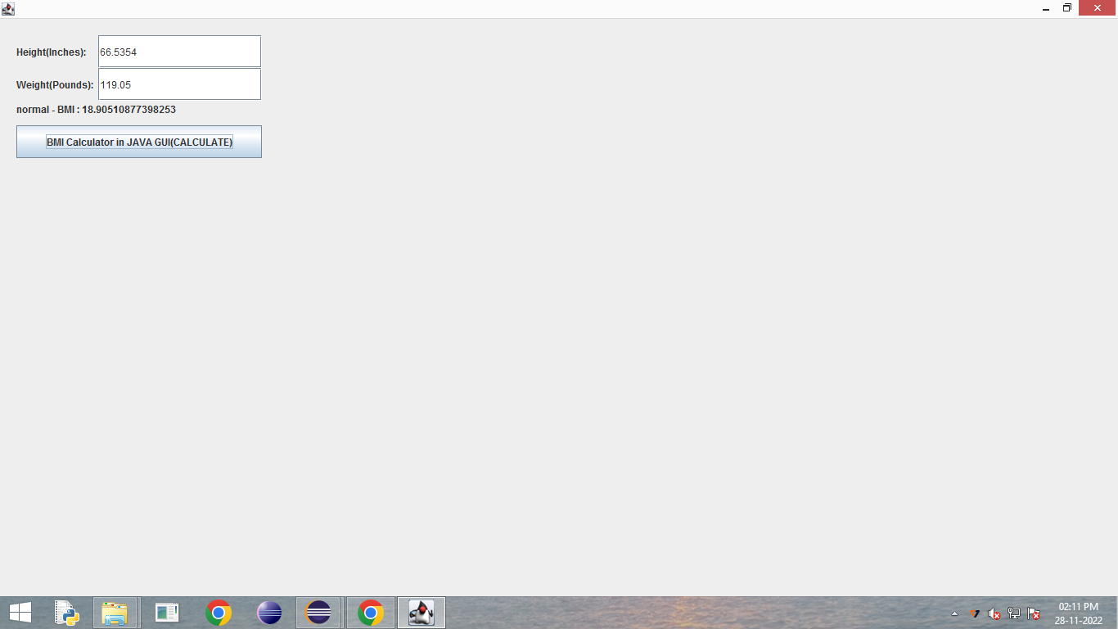
OUTPUT

Slide 9
Thank you !

